Slide 1

Health Insurance Cost Prediction
- Maganti. Manogna Venkata Sudha Anirudh

Slide 2

Contents:
Introduction
Data Description
Exploratory Data Analysis (EDA)
Modeling Overview
Methodology
Bayesian Linear Regression
Bayesian Multi-Linear Regression
Model Performance Comparison
Conclusion

Slide 3
Introduction
In the complex landscape of insurance pricing, the quest for precision and reliability in predicting costs has become increasingly vital. Yet, the conventional methods rooted in frequentist approaches reveal inherent limitations, relying heavily on rigid data assumptions and lacking the adaptability required in today's dynamic insurance ecosystem. Recognizing these constraints, there's a burgeoning interest in alternative modeling methodologies, particularly in the realms of Bayesian modeling and machine learning.
The significance of accurately predicting insurance costs cannot be overstated. It serves as a linchpin for individuals and businesses alike, enabling prudent financial planning and risk mitigation strategies. Moreover, for insurance companies, the ability to set fair premiums while remaining competitive is contingent upon robust predictive models.
This project embarks on a journey leveraging Bayesian methodology, specifically employing Markov Chain Monte Carlo (MCMC) techniques and computational tools, to model insurance prices. While recognizing the importance of traditional regression models like Linear Regression, Ridge Regression, Lasso Regression, Decision Tree Regressor, Random Forest Regressor, and XGBoost Regressor, this study seeks to expand the horizon by delving deeper into the Bayesian approach.
The focus here extends beyond conventional approaches by embracing Bayesian Linear Regression and Bayesian Multiple Linear Regression. The intent is to compare and contrast these Bayesian models against the aforementioned regression models, gauging their efficacy based on metrics like R Square and RMSE. By doing so, we aim to uncover the strengths and advantages of Bayesian modeling in predicting insurance costs, potentially offering a more nuanced and accurate understanding that transcends the limitations of traditional frequentist techniques.

Slide 4
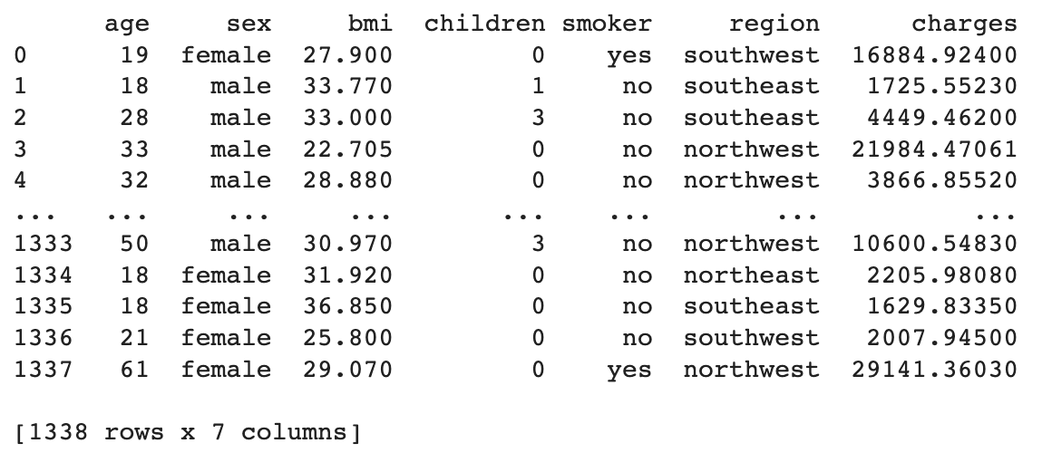
Data Description
The dataset comprises of several crucial features. It includes the age of insured individuals, their gender ('female' or 'male'), their Body Mass Index (BMI), which serves as a metric for assessing body weight, the number of children or dependents they have, their smoking status (categorized as 'yes' for smokers and 'no' for non-smokers), the geographic region to which they belong (with categories like 'southwest,' 'southeast,' 'northeast,' and 'northwest’). The final column, "charges," quantifies the health insurance costs for each policyholder, serving as the target variable for predictive modeling.

Slide 5
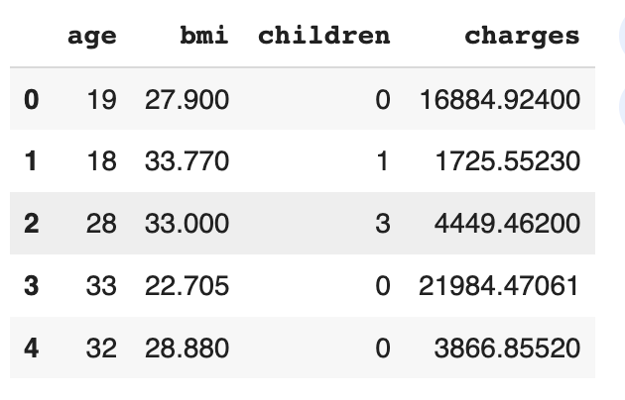
Exploratory Data Analysis (EDA)
Exploratory Data Analysis Overview
In the initial phase of exploration, a dataset of dimensions 1338x7 was loaded,
revealing no missing values across the entirety of the dataset.
Numerical Features Analysis (I.2)
Extraction and examination of numerical features:

Slide 6
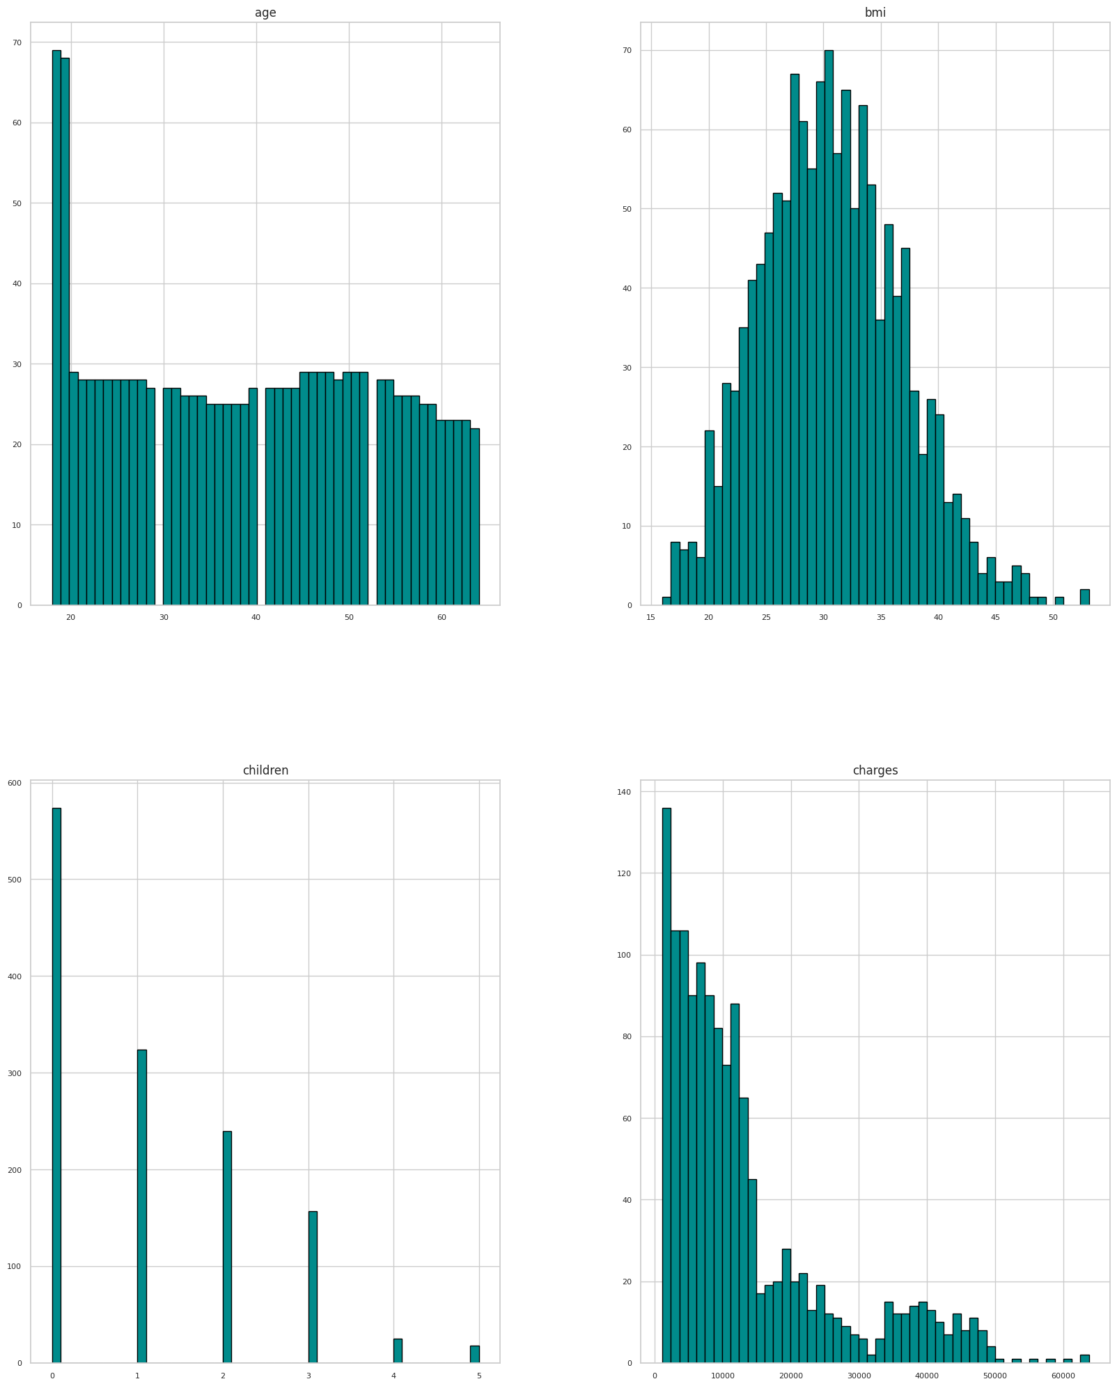
Exploratory Data Analysis (EDA)
Features distribution:

Slide 7
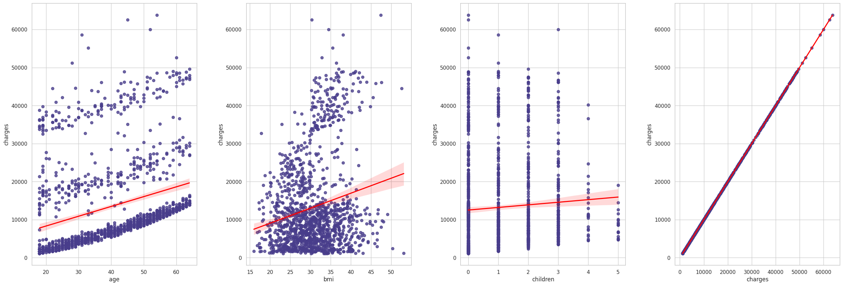
Exploratory Data Analysis (EDA)
Scatterplot & Relationship Assessment:

Slide 8
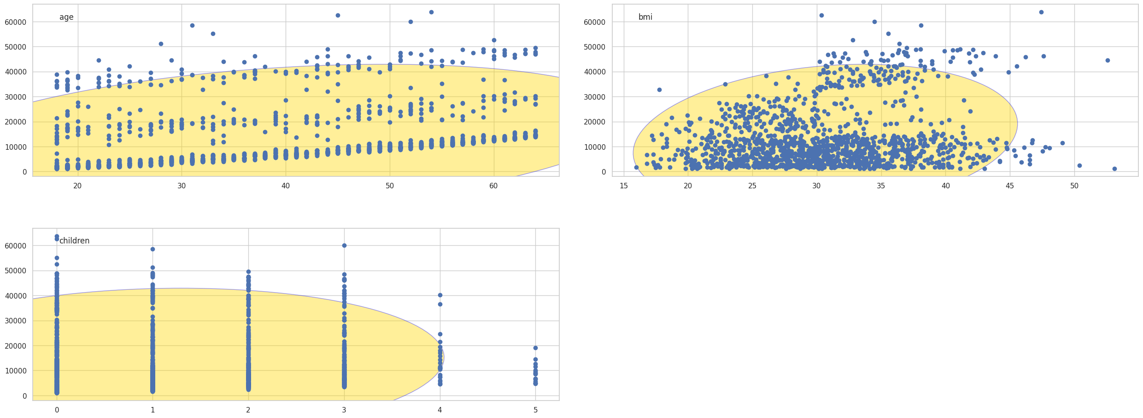
Exploratory Data Analysis (EDA)
Bivariate Outliers detection Using Mahalanobis Distance:
Mahalanobis Distance (MD) is an effective distance metric that finds the distance between the point and the distribution. It works quite effectively on multivariate data because it uses a covariance matrix of variables to find the distance between data points and the center. This means that MD detects outliers based on the distribution pattern of data points, unlike the Euclidean distance.

Slide 9
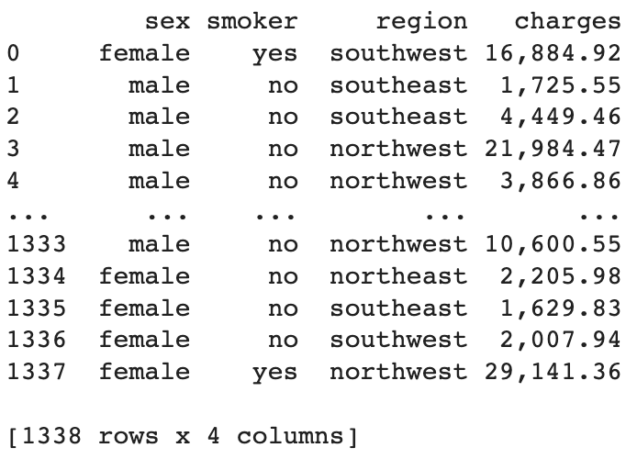
Exploratory Data Analysis (EDA)
Categorical Features Analysis (I.3)
Extracting Categorical Features:

Slide 10
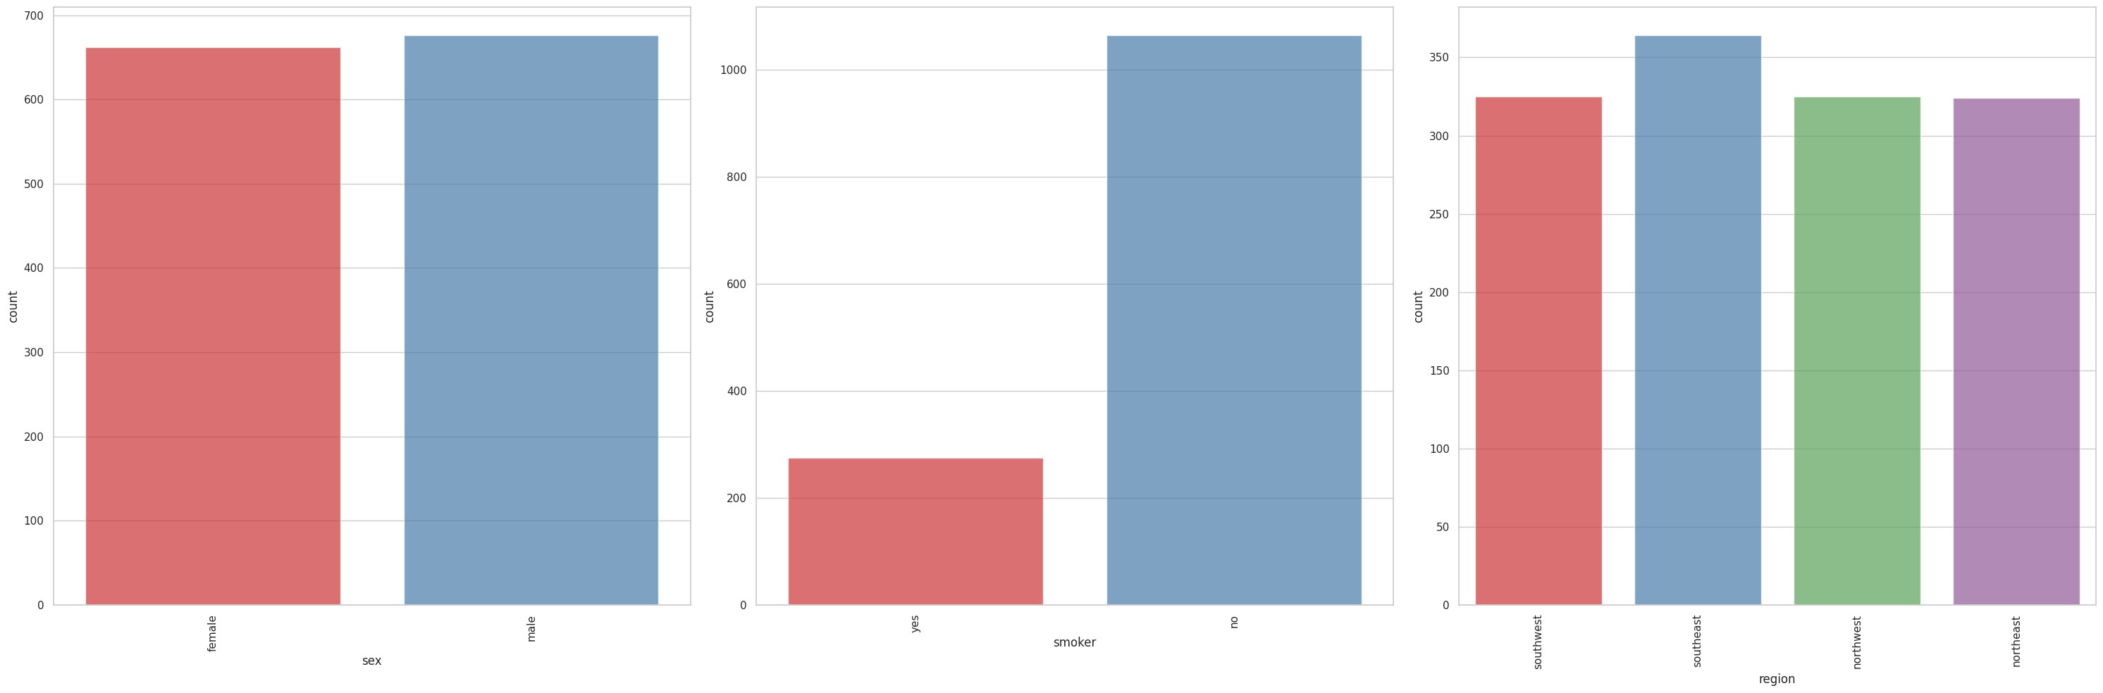
Exploratory Data Analysis (EDA)
Counter Plots: A count plot can be thought of as a histogram across a categorical, instead of quantitative variable. As a result, we don't want those predictors with a prevalent outcome such as smoker for instance because they don't contribute significantly to training our model.

Slide 11
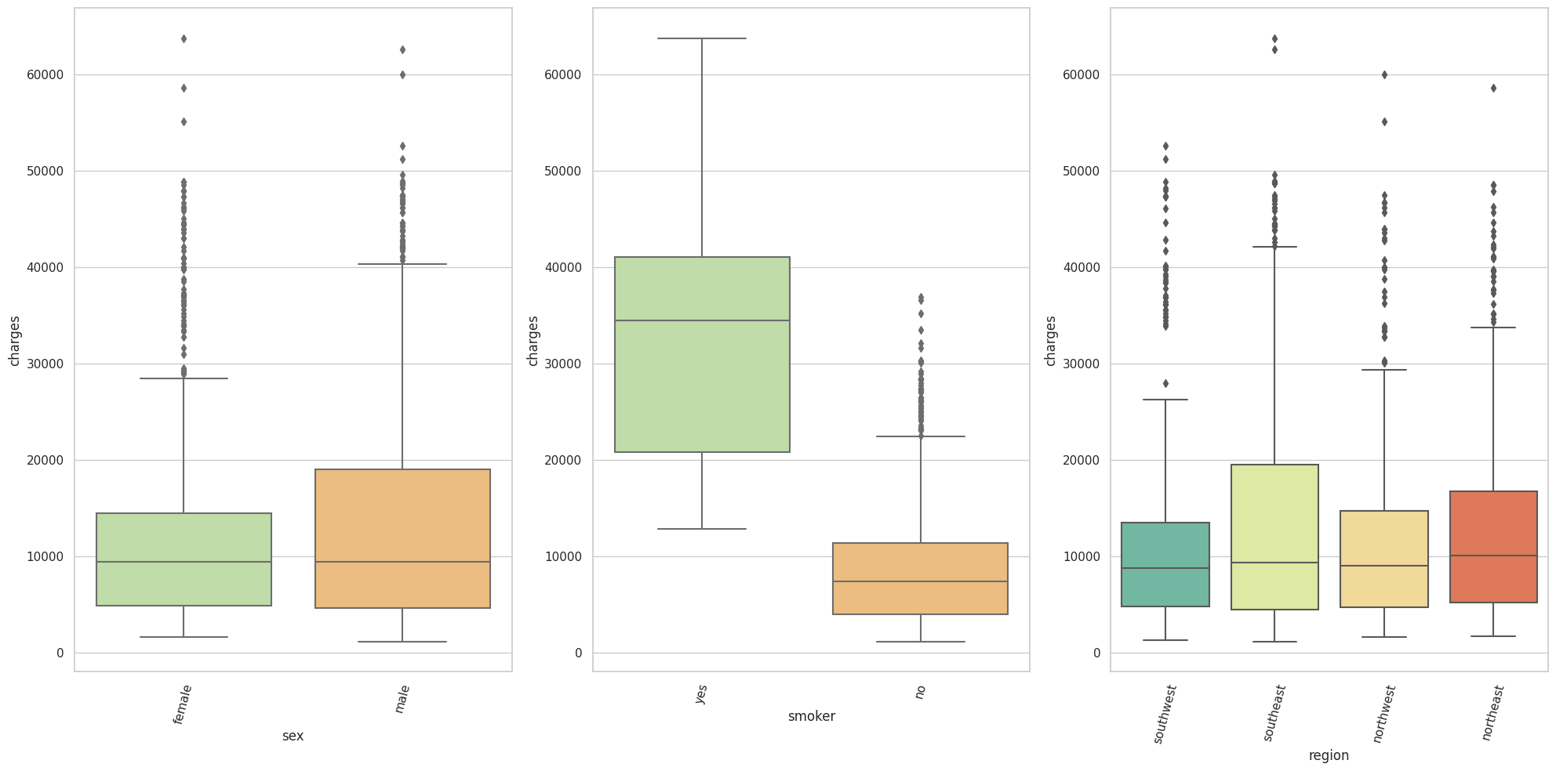
Exploratory Data Analysis (EDA)
Box Plot: Secondly, it's worth a look at the variation of the target variable with respect to each categorical feature.
Box Plots

Slide 12
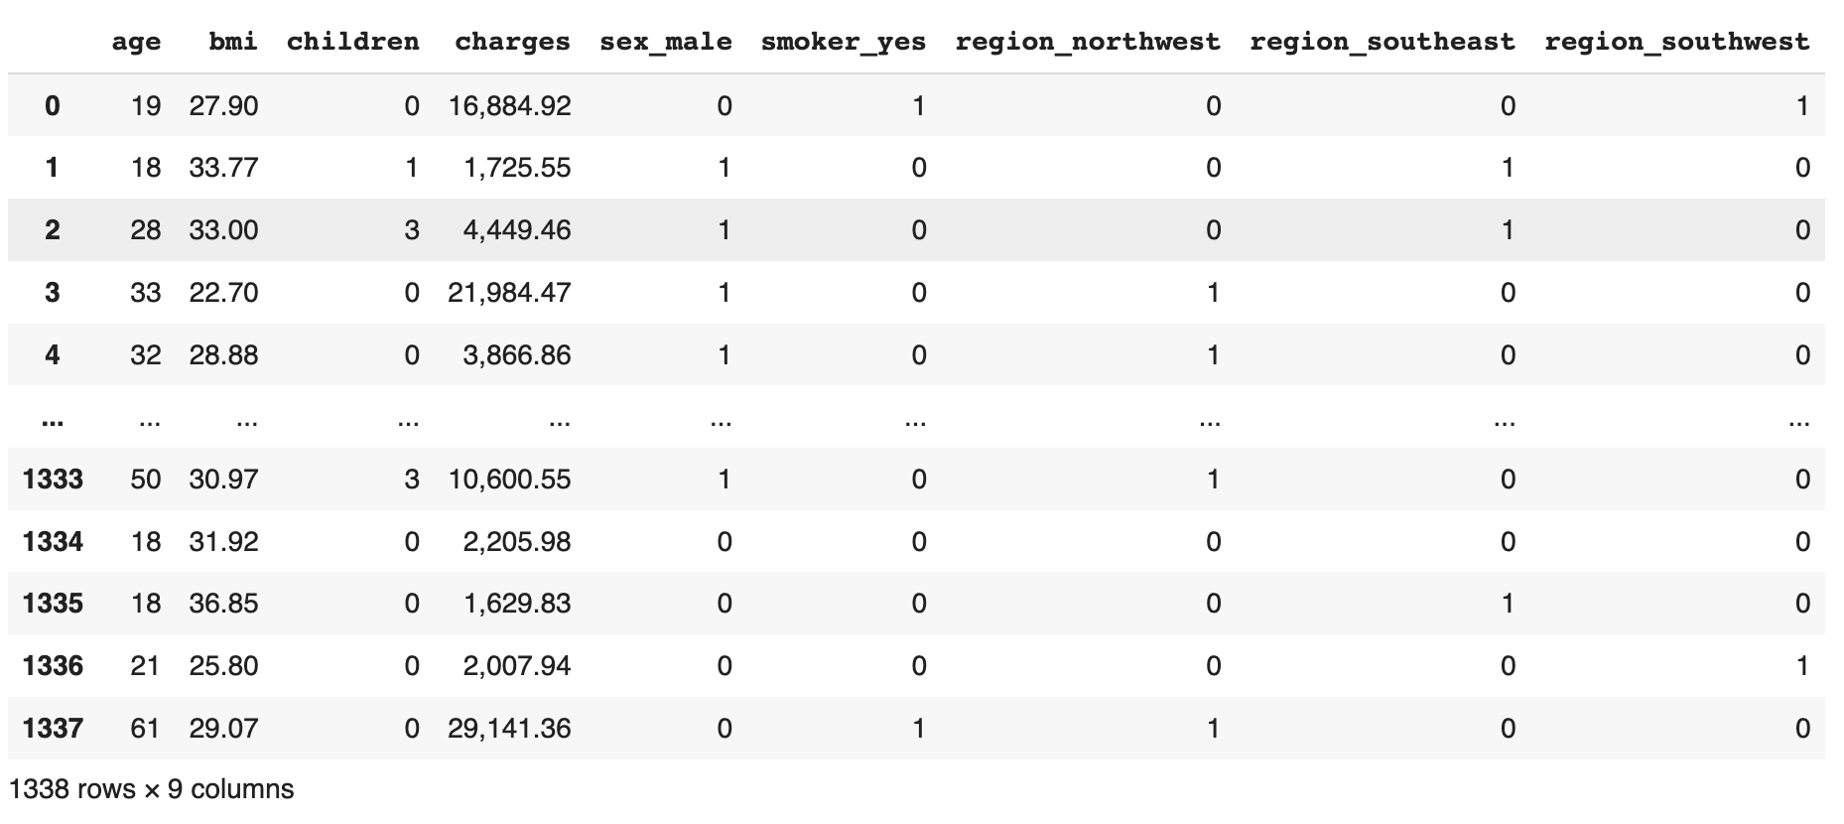
Exploratory Data Analysis (EDA)
Transform Categorical features into Binary features & Merge numerical and binary features into one data set :
Train set: (1338, 9)

Slide 13
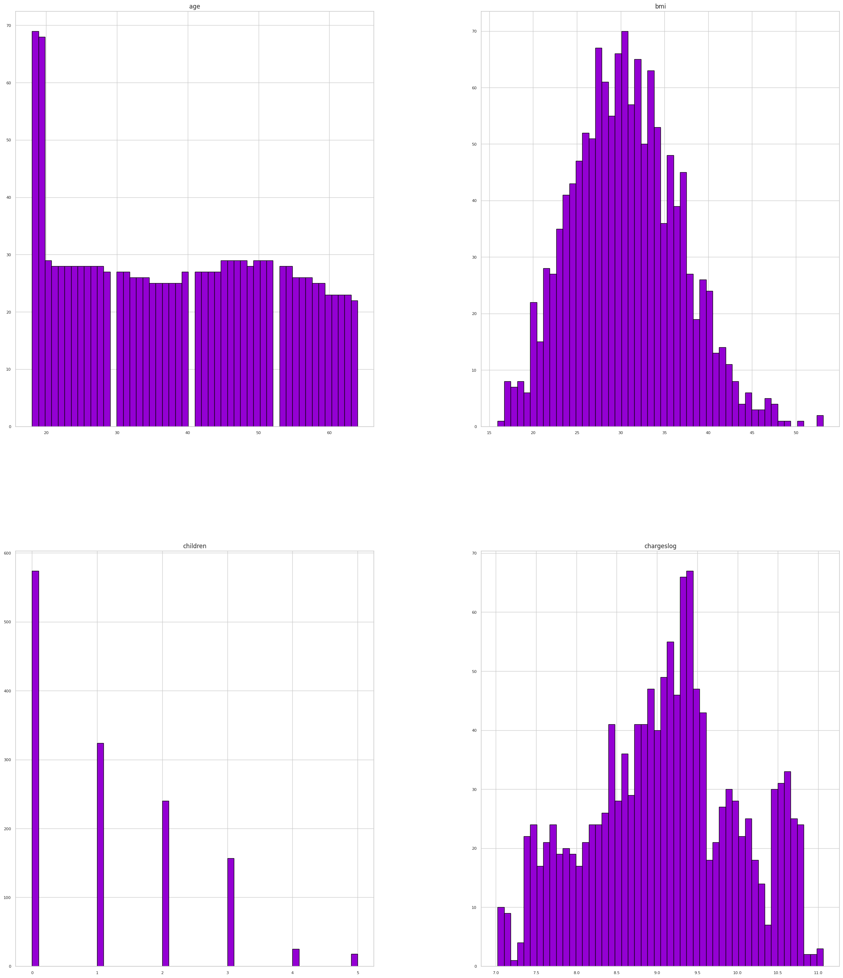
Exploratory Data Analysis (EDA)
Looking at the distribution of the numerical features right from the beginning, we can notice that "charges" is skewed as well. To help normalize this variable, a log transformation will be applied to "charges".

Slide 14

Modeling Overview
Linear Regression
Ridge Regression
Lasso Regression
Random Forest Regressor
XGBoost Regressor
To measure model performance and their predictions the RMSE and R^{2} scores will be used.

Slide 15
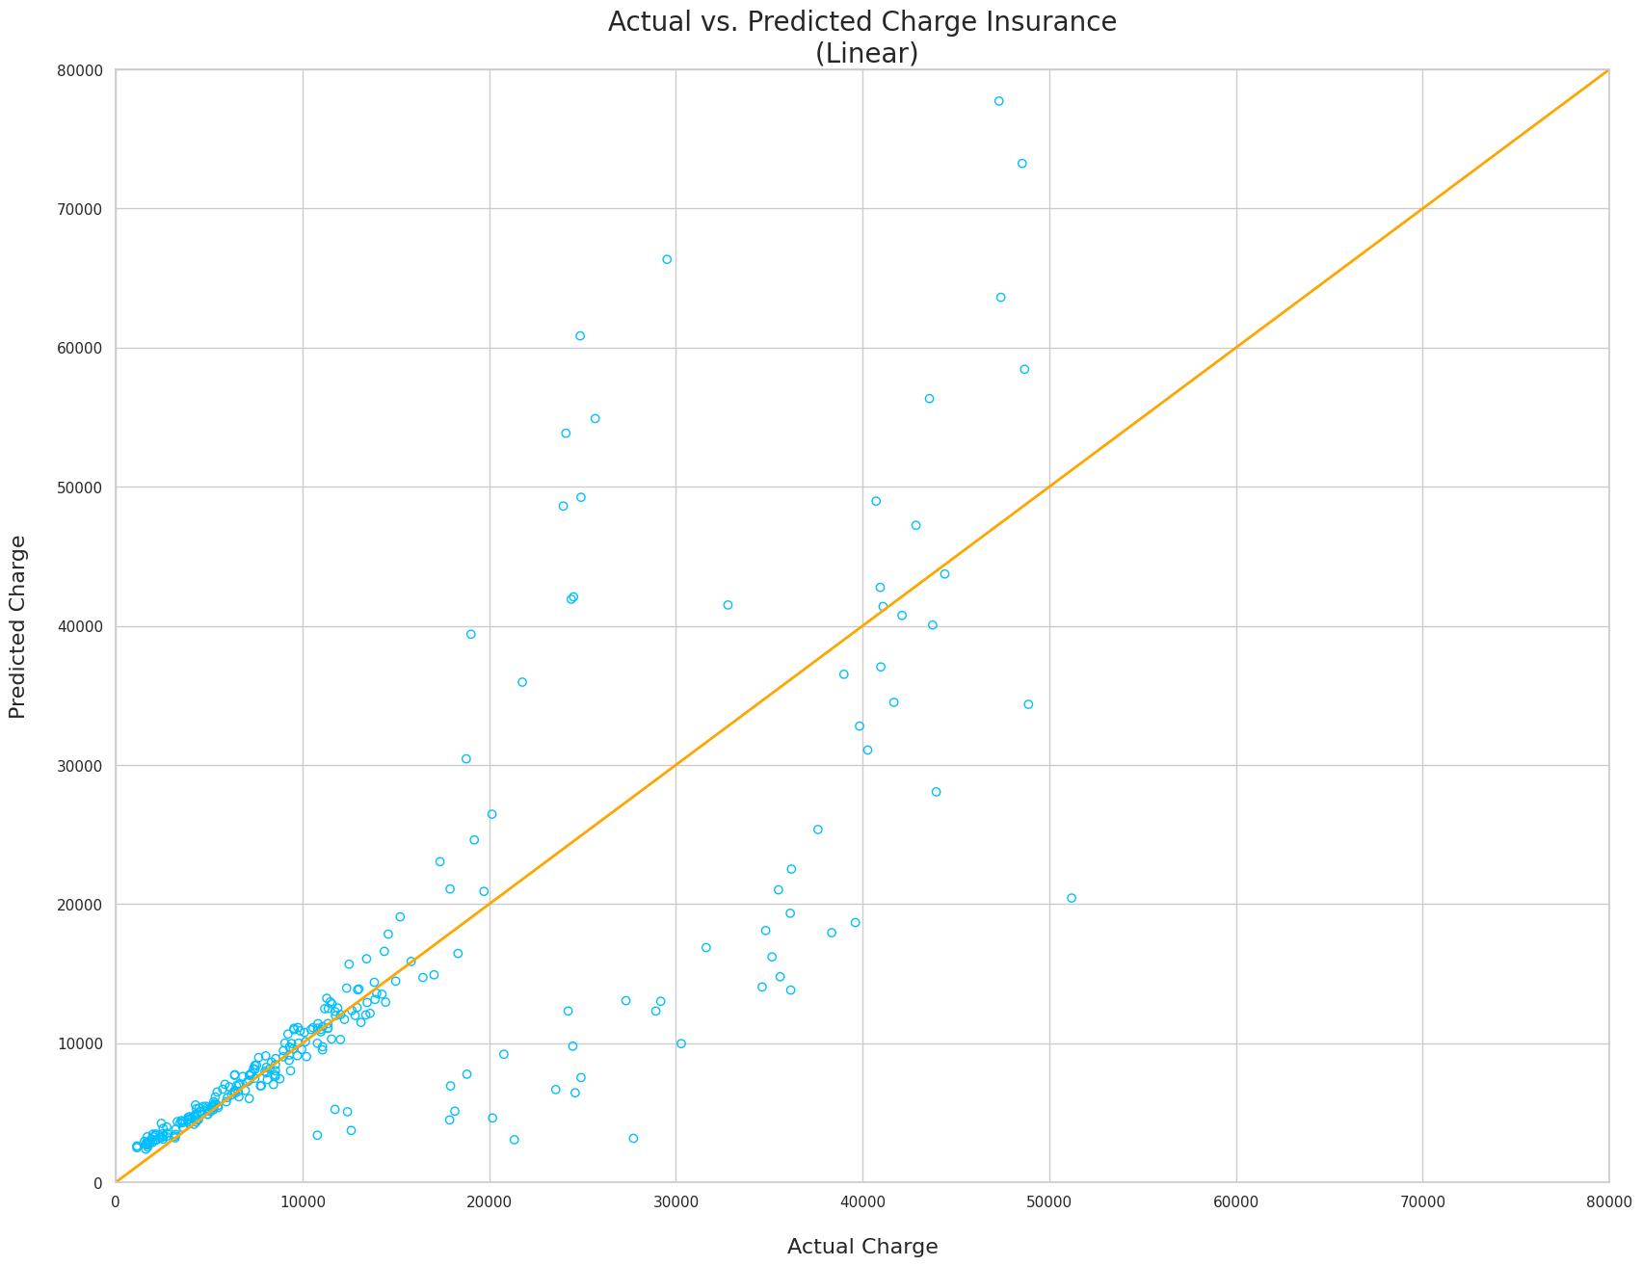
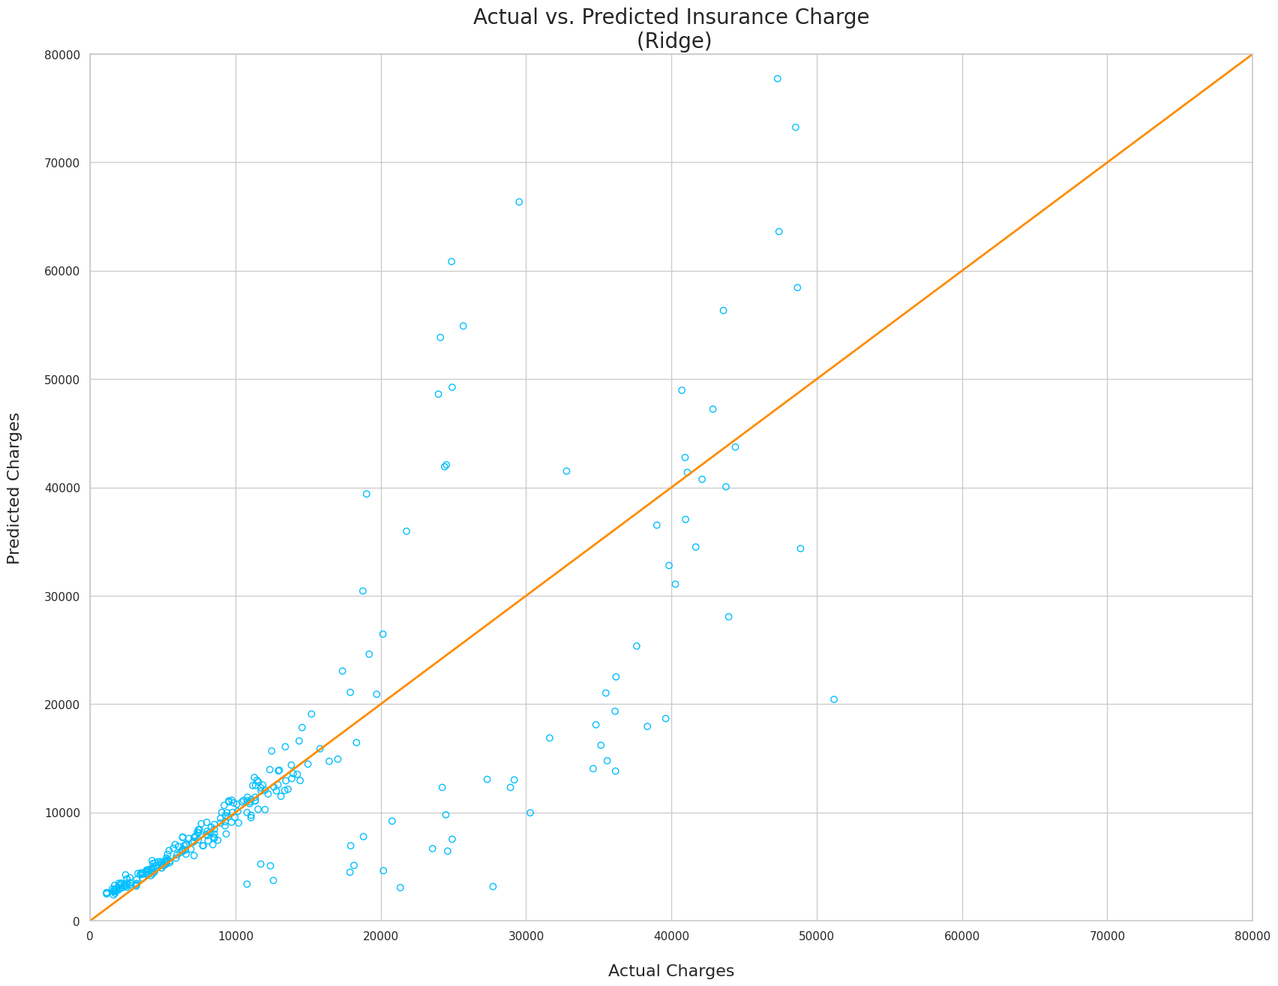
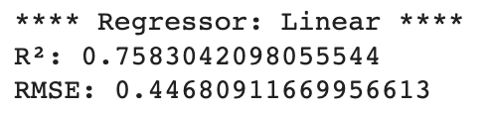
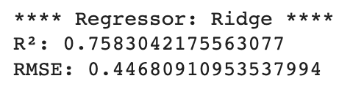
Modeling Overview
Linear Regression:
Ridge Regression:

Slide 16
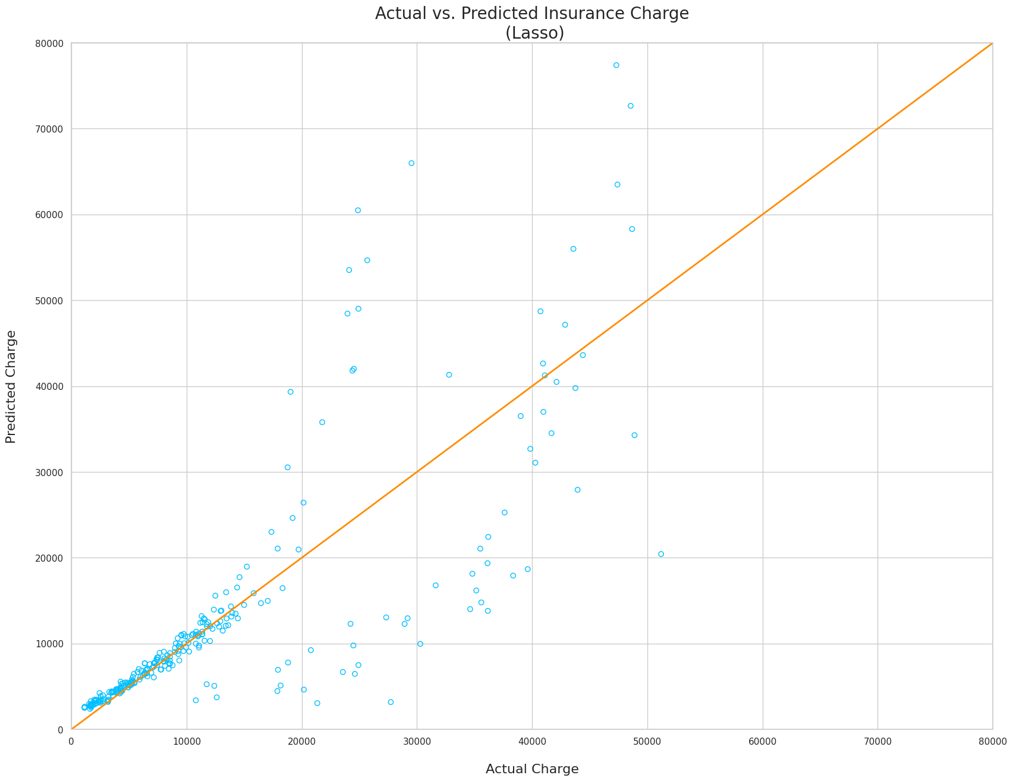
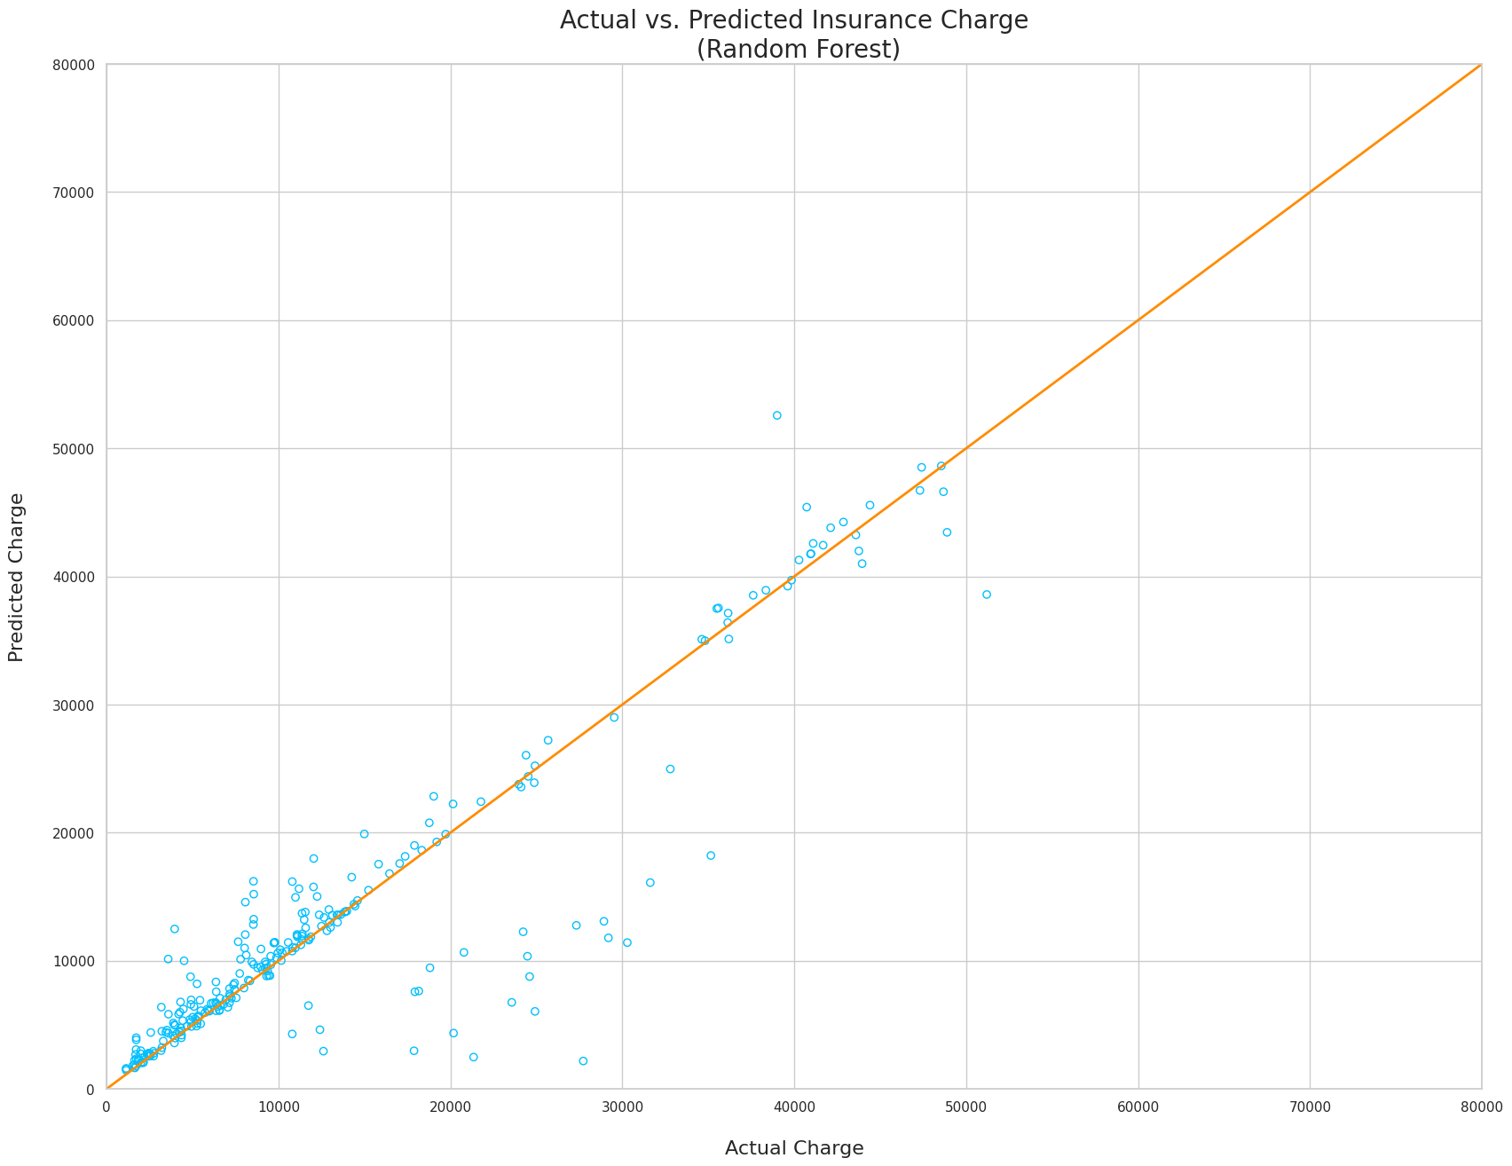
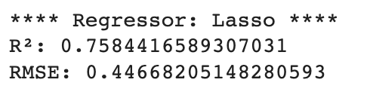
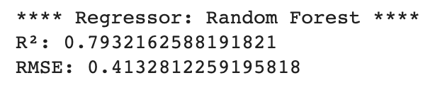
Modeling Overview
Lasso Regression:
Random Forest Regressor:

Slide 17
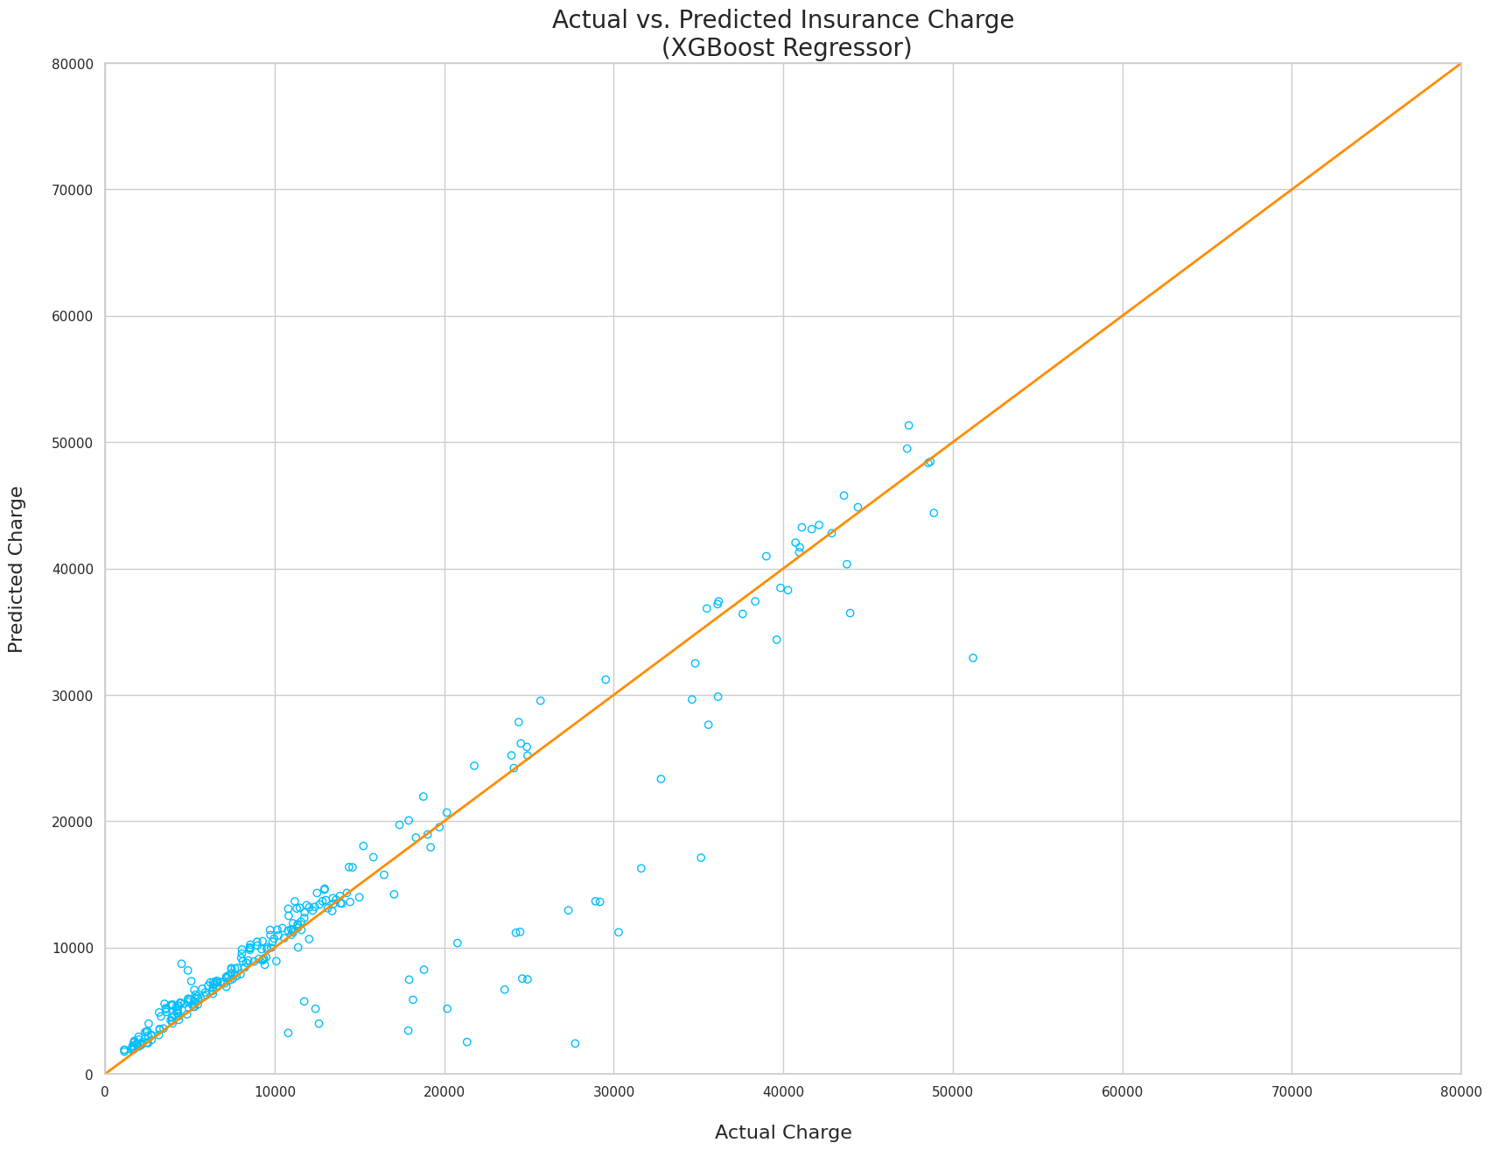
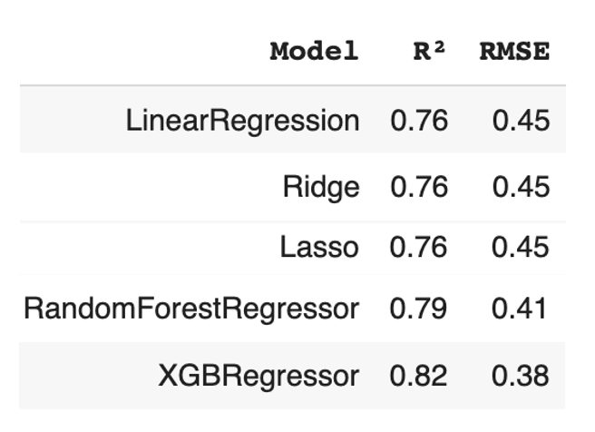
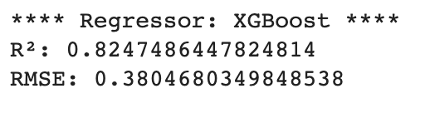
Modeling Overview
XGBoost Regression:

Slide 18

Bayesian Model - MCMC
The Bayesian approach, specifically using Markov Chain Monte Carlo (MCMC), is applied in this project for modeling health insurance costs. MCMC is used to estimate posterior distributions of model parameters(intercept & slope), allowing for uncertainty quantification and more robust predictions. The Bayesian approach contrasts with traditional frequentist methods by offering a comprehensive view of parameter uncertainty and incorporating prior knowledge.

Slide 19
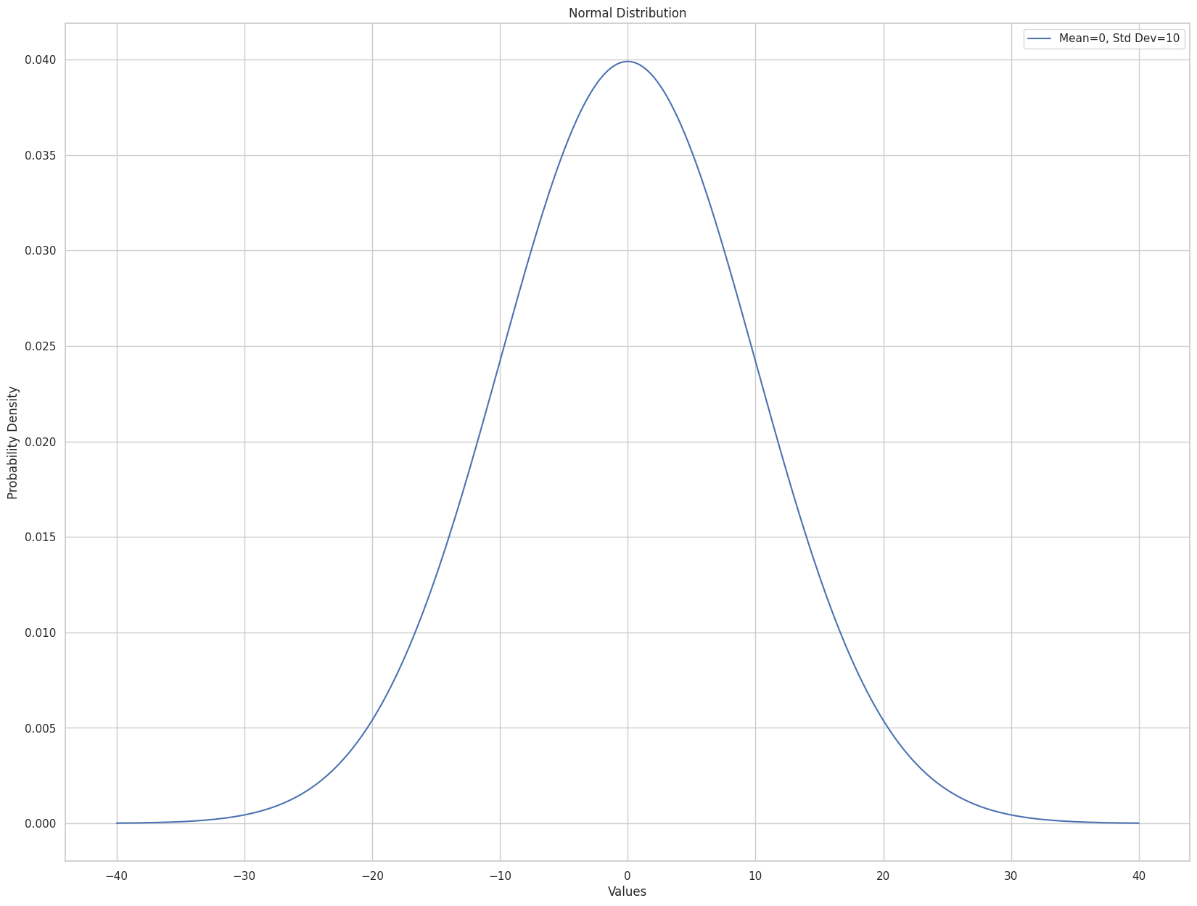
Bayesian Methodology:
MCMC for Linear Regression Models:
Prior Probability (Prior):
Before seeing any medical charges data, the prior distributions express our uncertainty about the parameters
Here, the priors in our model are P(Intercept),P(beta)
These represent our initial beliefs about the intercept and slope (beta) parameters before observing the medical charges data. We are assuming normal distributions with mean 0 and standard deviation 10 as prior distributions for the intercept and beta parameters.

Slide 20
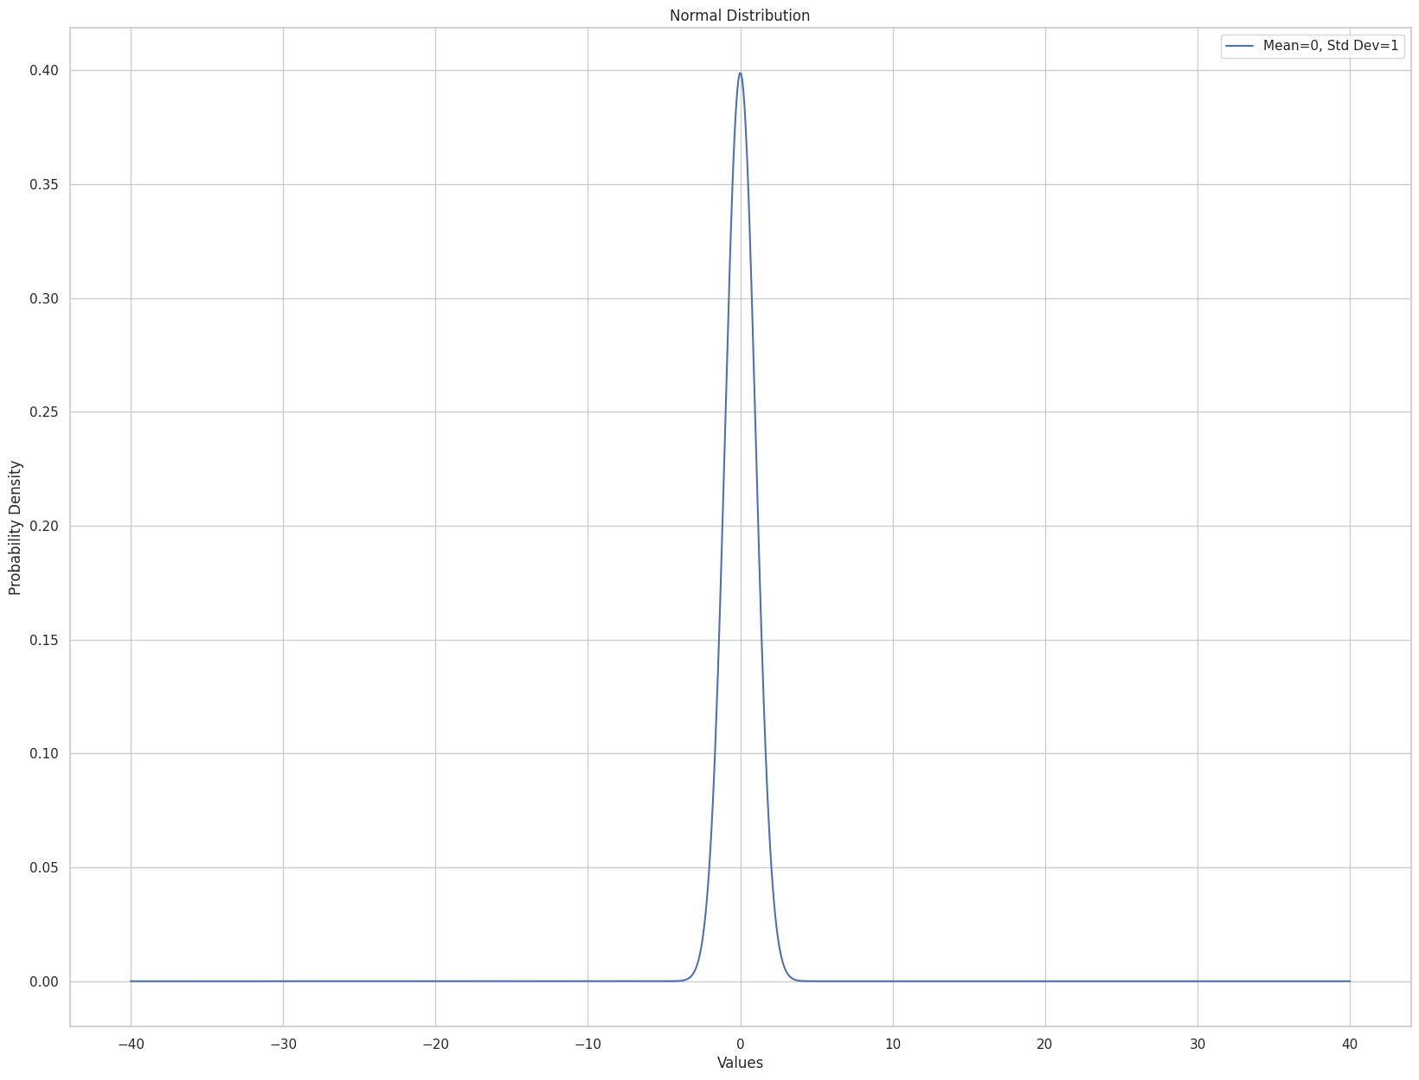
Bayesian Methodology:
Likelihood:
P(charges∣Intercept,beta,BMI)
It quantifies how likely observed charges are for different combinations of intercept, slope, and BMI.
This represents the probability of observing the medical charges data given specific values of the intercept, slope, and BMI. We are considering a Normal likelihood assuming charges follow a Normal distribution around the predicted values based on the linear model, with a standard deviation of 1.

Slide 21
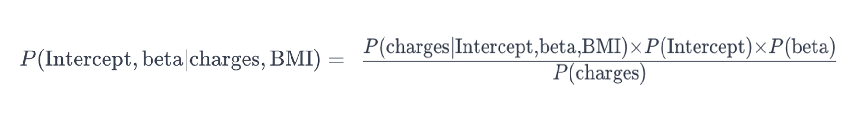
Bayesian Methodology:
Posterior Probability (Posterior):
P(Intercept,beta∣charges,BMI)
After analysing the medical charges data, the posterior distributions represent our updated understanding of the intercept and slope values.
This is our updated belief about the intercept and beta parameters after considering the observed medical charges data and BMI. It's a combination of the prior beliefs and what the data tells us about the parameters.
Prior distributions express initial uncertainty about the intercept and slope parameters.
Likelihood calculates the probability of observing charges given specific intercept, slope, and BMI values.
Posterior distributions represent updated beliefs about the intercept and slope parameters after observing medical charges data and BMI, combining prior knowledge with observed evidence.

Slide 22
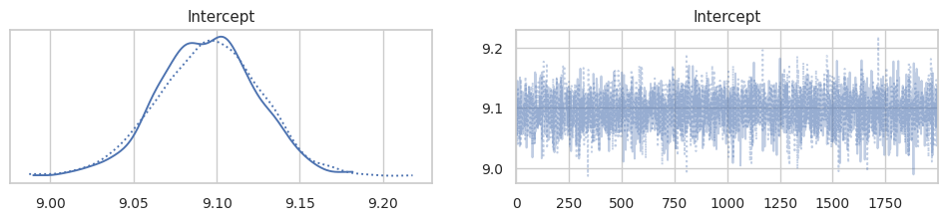
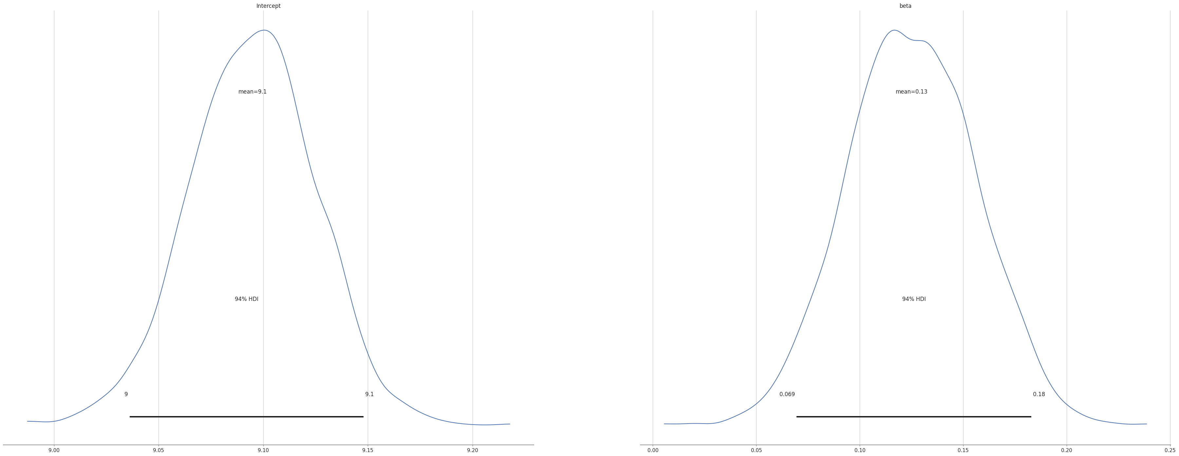
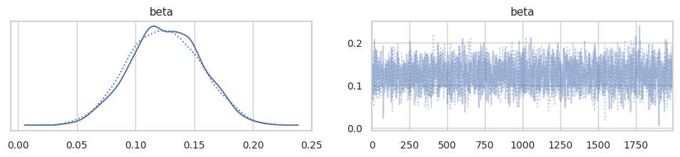
Bayesian Linear Regression:
MCMC for Linear Regression Models:
Mean squared error: 0.82

Slide 23
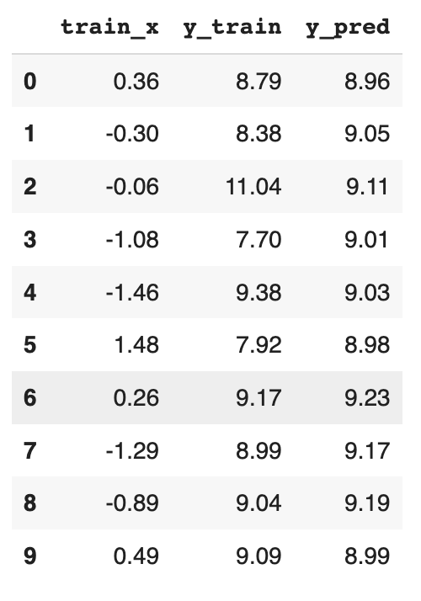
Bayesian Linear Regression:

Slide 24
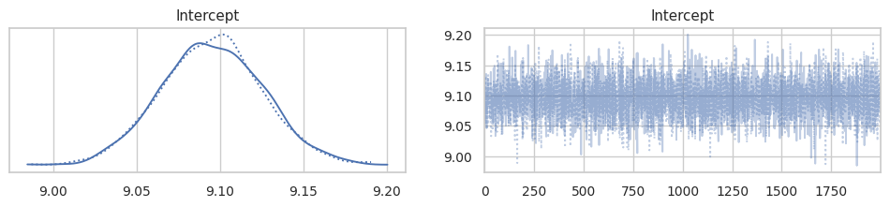
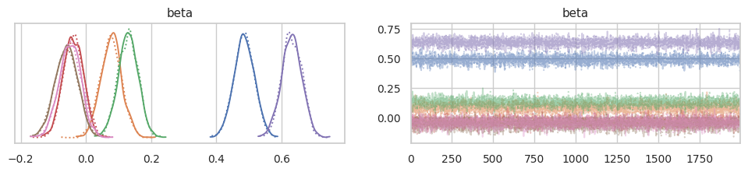
Bayesian Multiple Linear Regression:
Results on Train(1070, 7) data:

Slide 25
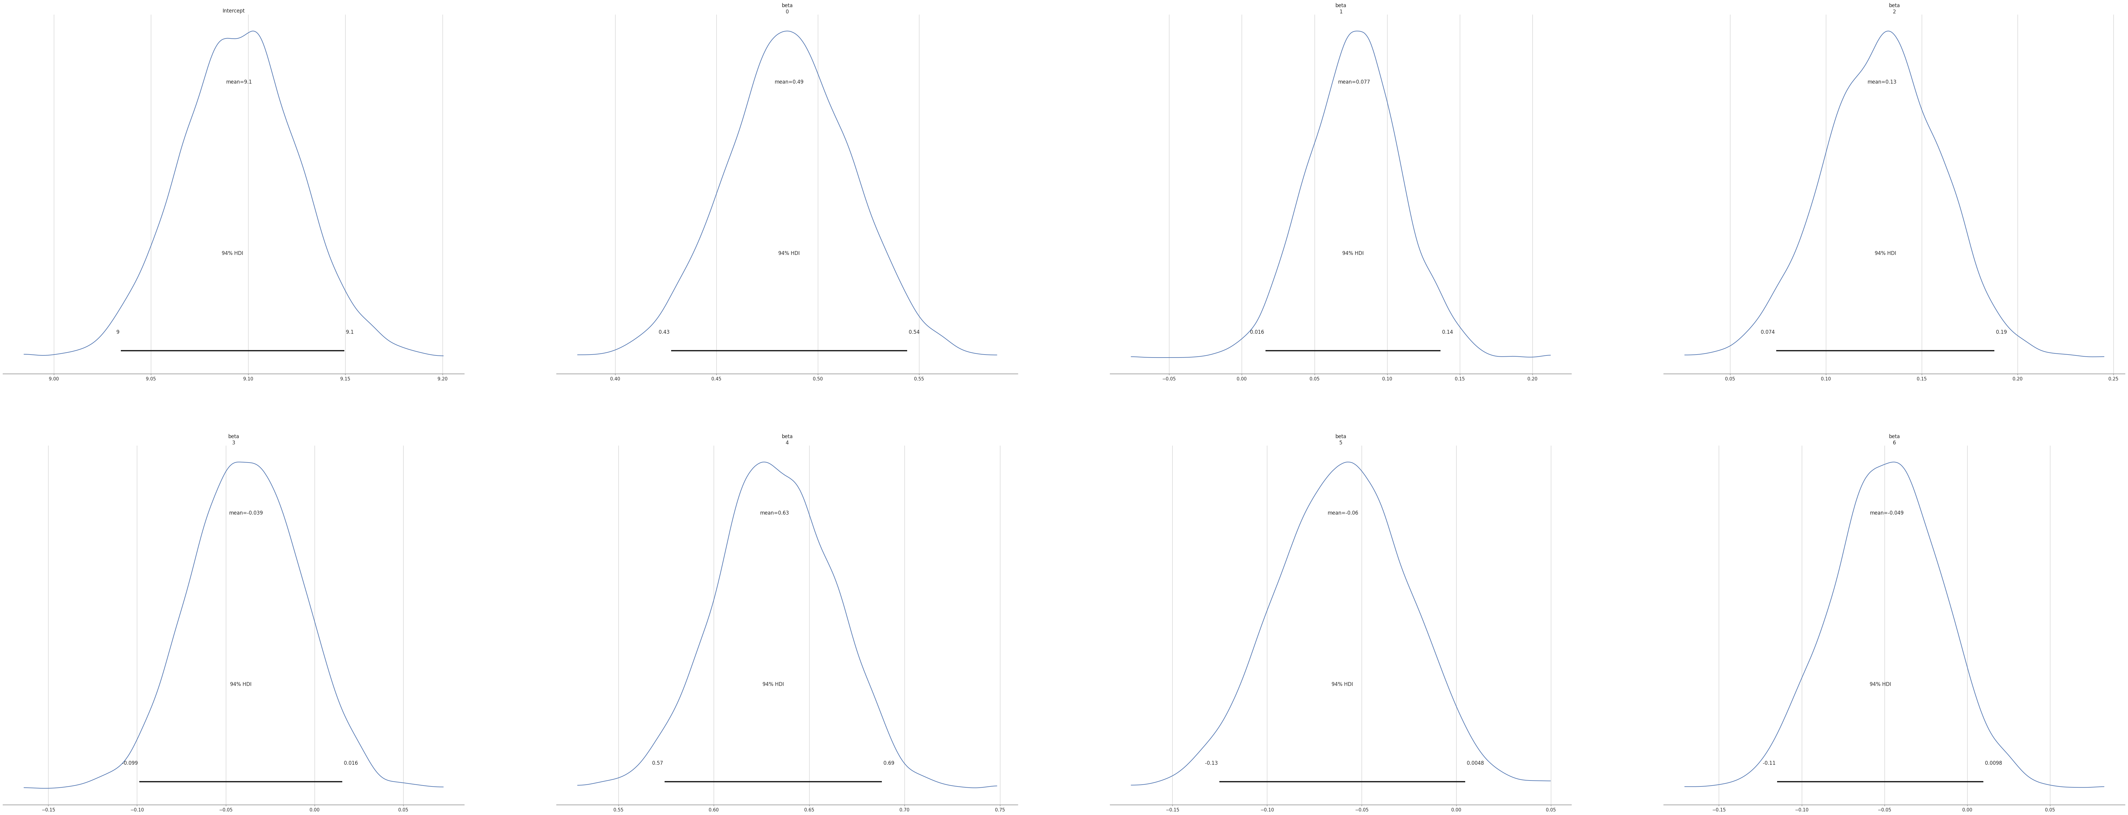
Bayesian Multiple Linear Regression:
Results on Train(1070, 7) data:

Slide 26
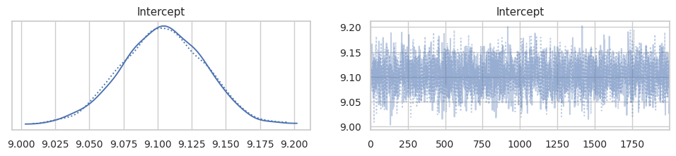
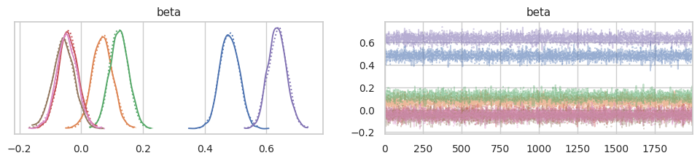
Bayesian Multiple Linear Regression:
Results on Test(268, 7) data:

Slide 27
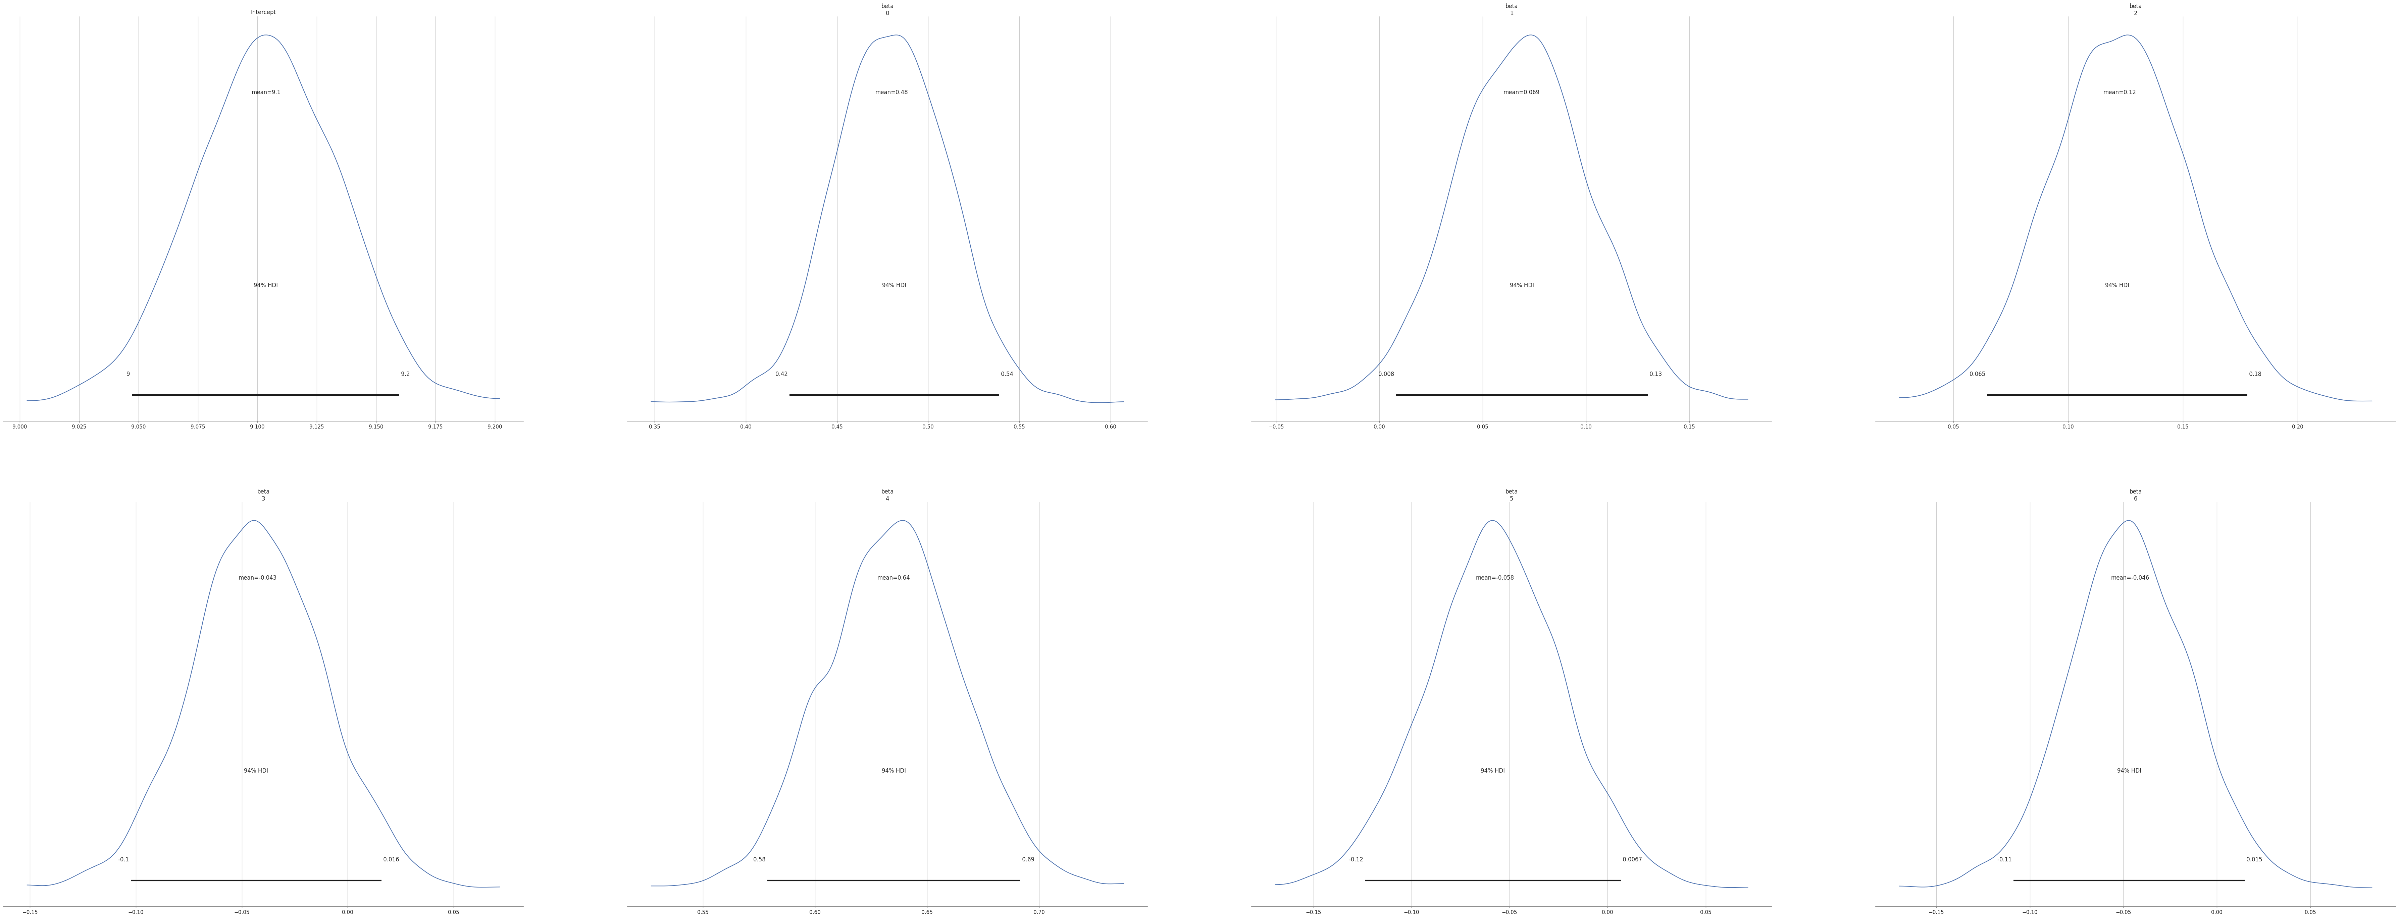
Bayesian Multiple Linear Regression:
Results on Test(268, 7) data:

Slide 28
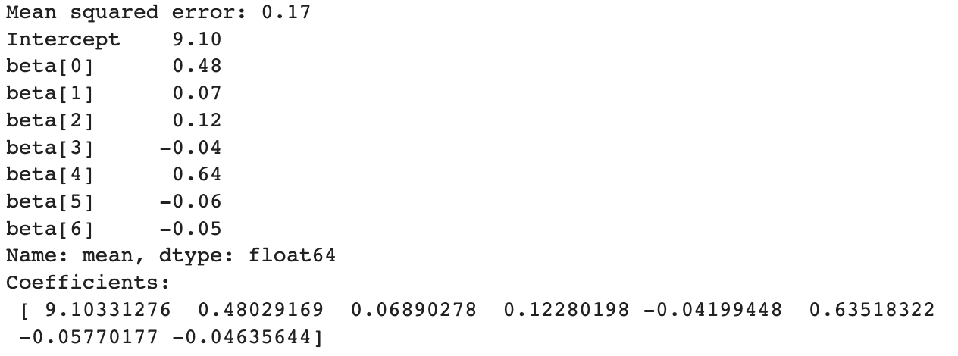
Bayesian Multiple Linear Regression:
Results on Test(268, 7) data:
y_pred = beta[0]x1+ beta[1]x2+ beta[2]x3+ beta[3]x4+ beta[4]x5+ beta[5]x6+ beta[6]x7+Intercept
y_pred = 0.48(age)+ 0.07(bmi)+ 0.12(children)- 0.04(sex_male)+ 0.64 smoker_yes) - 0.06(region_southeast)- 0.05(region_southwest)+9.10

Slide 29
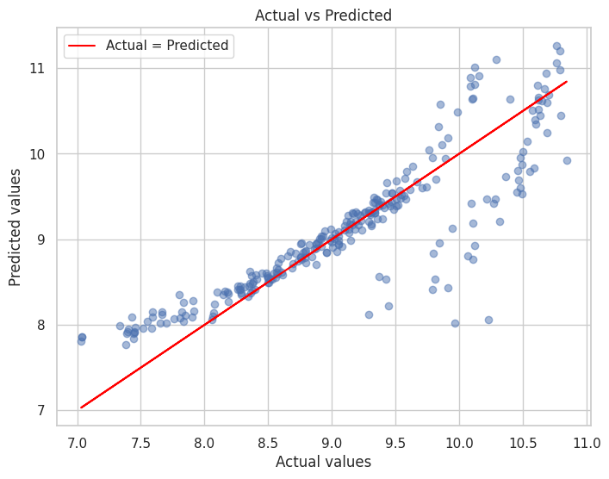
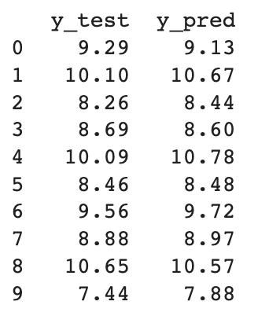
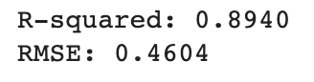
Bayesian Multiple Linear Regression:
Results on Test(268,7) data:
y_pred shape = (268, 2000)

Slide 30
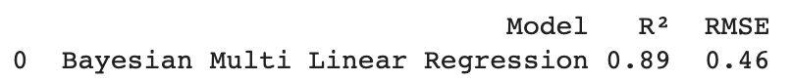
Model Performance Comparison:
Without Bayesian:
With Bayesian:

Slide 31

Conclusion:
The Bayesian linear regression may have a smaller mean squared error compared to the least squares linear regression due to the uncertainty estimates provided by the Bayesian model. In Bayesian linear regression, we estimate the posterior distribution of the model parameters given the data, which allows us to obtain a range of plausible values for the parameters, instead of a single point estimate as in least squares regression.
This uncertainty estimate can be particularly helpful in situations where we have limited data or when the data is noisy or has outliers. The uncertainty estimates can help to regularize the model and reduce overfitting. Additionally, Bayesian models allow for the incorporation of prior knowledge, which can be useful in situations where we have some prior knowledge about the relationship between the variables.
Therefore, the Bayesian approach may provide a more robust estimate of the parameters, resulting in better predictions and a smaller mean squared error compared to the least squares approach.

Slide 32

Thank You !

